Slide 1
Study the example in groups and say when the Present Simple is used.

Slide 2
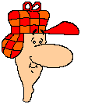

I speak a lot at the conference.

Slide 3
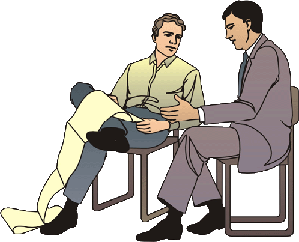

We study English together.

Slide 4
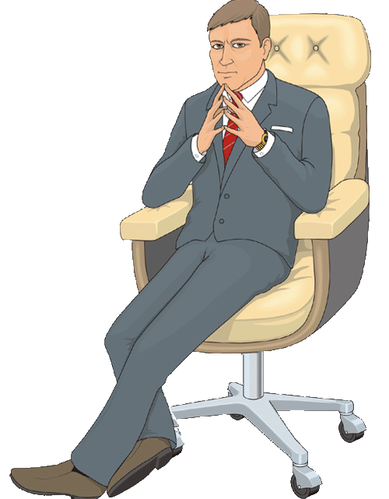

I work at EPAM.

Slide 5
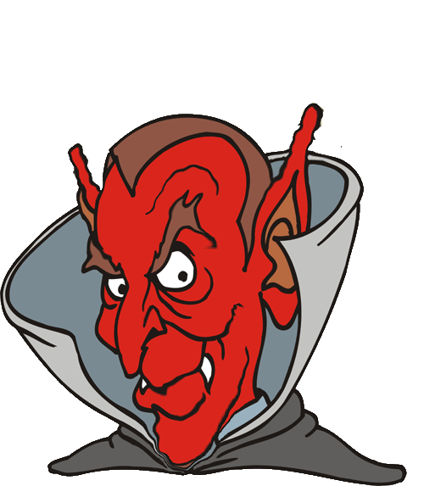

I like IT specialists.

Slide 6
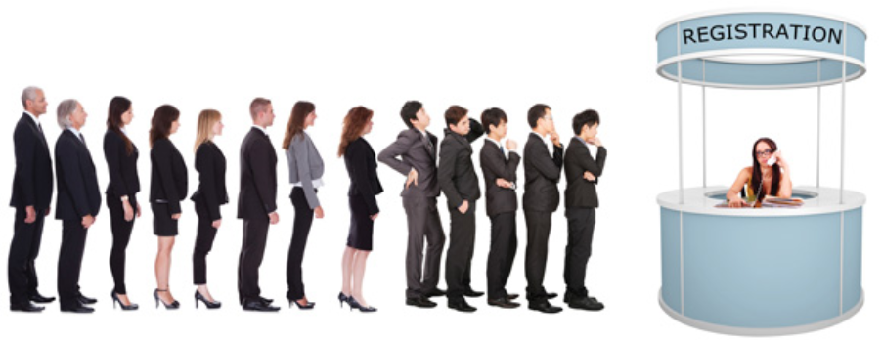
The registration starts at 10 a.m.

Slide 7



Use:
We use the simple present when we talk about things that happen regularly, repeatedly or all the time.
Use
The earth goes around the sun.

Slide 8

Use:
Use
We use the simple present when we talk about our present habits.
I play basketball every weekend.

Slide 9

Use
I cycle to work every day.

Slide 10


Use
I swim every weekend.

Slide 11
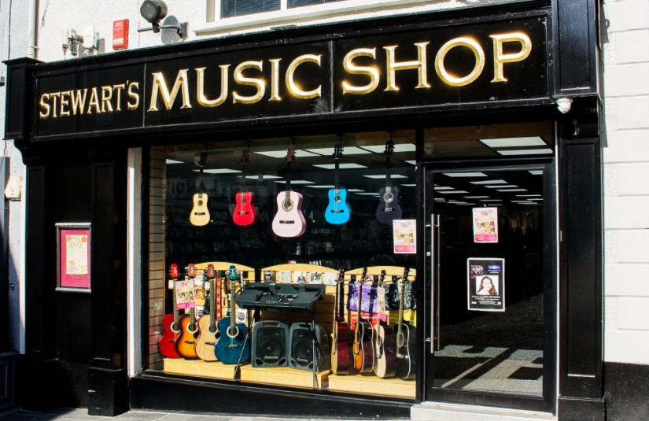
Use:
Use
We use the simple present when we talk about scheduled or timetabled events.
The shop opens at 9 a.m.

Slide 12
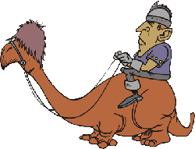

Use:
We use signal words:
sometimes, often, usually, always, never, once in a blue moon, frequently, rarely, seldom, hardly ever, once a day /a week / a month; twice a day /a week / etc., occasionally
Use
I always go to work early.

Slide 13
Study the example and say how the Present Simple is formed.

Slide 14
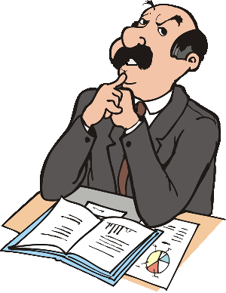

The simple present tense is:
pronoun or noun + verb without to
PRONOUN
I work overtime.
VERB

Slide 15


We add “s” end of the verbs in third person singular.
“I / you / we / they read” but “He / she / it reads”
s
They work in a bank.
but
He works in a bank.
“I / you / we / they have” but “He / she / it has”
I have meetings every day.
but
John has meetings every day.

Slide 16


adding "s"
work works
sit sits
stay stays
Most verbs:
add –s to infinitive
s
Verbs ending in consonant + y
drop y and add -ies
cry cries
hurry hurries
reply replies
Verbs ending in –s, -z, -ch, -sh, o, or x
add –es to infinitive
miss misses
watch watches
push pushes
do does
go goes
Exception:
have has

Slide 17




I don’t like online meetings.
We use “DON’T” here for I, YOU, WE, THEY.
We use “DOES’NT” here for HE, SHE, IT.
Do you like online meetings?
We use “DO” here for I, YOU, WE, THEY.
We use “DOES” here for HE, SHE, IT.

Slide 18
Forms:
Forms
Positive
Question
Negative
I work. You work. He works. She works. It works. We work. They work. | Do I work? Do you work? Does he work? Does she work? Does it work? Do we work? Do they work? | I don’t work. You don’t work. He doesn’t work. She doesn’t work. It doesn’t work. We don’t work. They don’t work.
don’t = do not
doesn’t = does not

Slide 19
Which statements are true about the Present Simple?
1
Is used to talk about regular, repeated actions
2
Is used to talk about schedule or timetable
3
Is used to talk about the action in progress
4
The signal words are: always / often / sometimes
5
The signal words are: now, always, rarely
6
Is used to talk about future plans

Slide 20
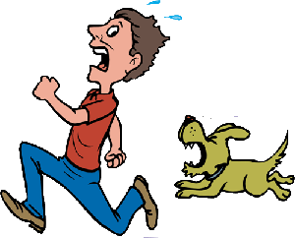
Exercises:
Exercises
Fill in the blanks with correct word.
I . . . . . like the dog.
not
does
doesn’t
don’t

Slide 21
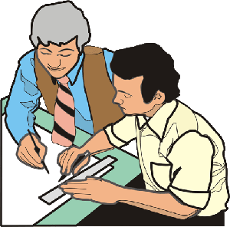
Exercises:
Exercises
Fill in the blanks with correct word.
. . . . . work very hard.
She
they
he
it

Slide 22
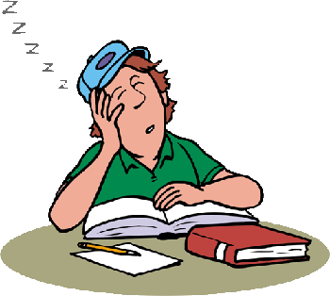
Exercises:
Exercises
Fill in the blanks with correct word.
. . . . . he like to do his homework?
not
does
doesn’t
don’t

Slide 23

Exercises:
Exercises
Fill in the blanks with correct word.
The earth.....................round the sun.
goes
doesn’t
go
don’t

Slide 24
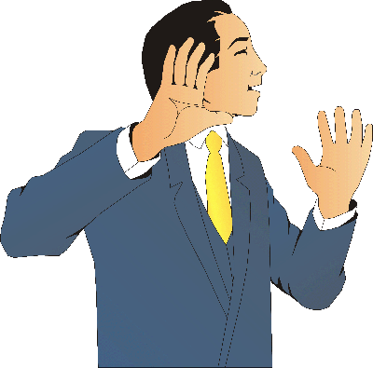
Exercises:
Exercises
Fill in the blanks with correct word.
He doesn’t ....... speaking so much.
likes
hates
wants
like

Slide 25
Exercises:
Exercises
Which one is wrong?
a) He doesn’t drink tea very often.
b) I usually plays tennis once or twice a week.
c) What do you suggest I do?
d) I promise I won’t be late.

